Slide 1
Steroid use and mortality in sepsis patients
Analysis of the MIMIC-IV database
2023-Apr

Slide 2
Introduction – Augmenting Sepsis treatment with Steroids is widely practiced
Sepsis is defined as a life-threatening organ dysfunction caused by a dysregulated response to infection
The mainstay of treatment is IV antibiotics, although other supportive measures such as hemodynamic management (with fluids and vasopressors), oxygen therapy (including mechanical ventilation) are also important
Steroids may be used in some patients due to their anti-inflammatory properties
Some meta-analysis have shown positive mortality outcomes of steroid use in sepsis patients, while there are some which have shown no effect. Nevertheless, many of these studies have significant heterogeneity.

Slide 3
Mixed consensus from prior Meta-Analyses on Sepsis Patients Treated with Steroids
Author | Year of Study | # of RCTs | 28-day Mortality | ICU Mortality | In-Hospital Mortality | Other Indicators
Fang et al | 2018 | 37 | â | â | â | 90-day mortality: no significant difference High dose corticosteroids: no significant difference
Liang et al | 2021 | 50 | No significant difference | â | â | -
Rochwerg et al | 2018 | 42 | No significant reduction | No significant reduction | No significant reduction | ICU LOS: no significant reduction Total LOS: no significant reduction

Slide 4
Rationale for study – To establish more conclusive evidence
Many of the meta-analyses had the problem of large clinical heterogeneity
Due to different diagnostic criteria of sepsis, management of sepsis
MIMIC-IV allowed us to look at huge numbers of retrospective data (large sample), while filtering for a common diagnostic criteria of sepsis, and were managed within the paradigm of recent clinical guidelines
Therefore, we utilized the MIMIC-IV database, which has > 40,000 patients' electronic health records to investigate the association between steroid administration in ICU patients with sepsis

Slide 5
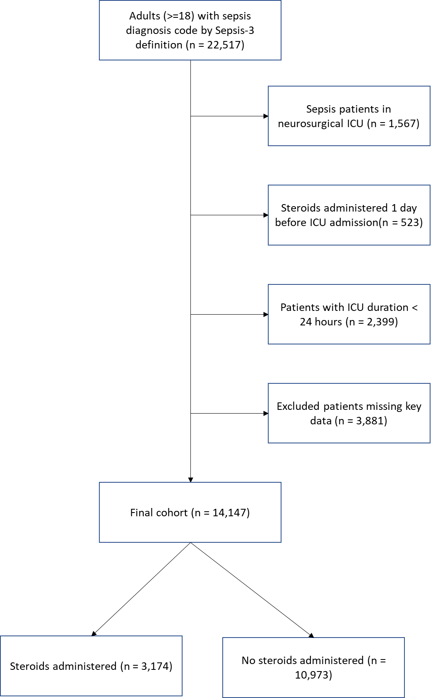
Inclusion/Exclusion Criteria (Cohort size = 14,147)
Inclusion Criteria
18 years old or older
Admitted to ICU for at least 24 hours
Meets sepsis diagnosis by Sepsis-3 definition
Exclusion Criteria
Admitted to neurological ICU
Steroids administered 1 day before ICU admission were excluded from analysis
Missing key data like heart rate, respiratory rate, Glasglow coma score
Notes:
Inclusion: Standard practice to include 18yrs or older – compare with other studies
Admitted to ICU > 24h so we get a more representative group of patients
Exclusion: remove other causes for administration of steroids, and maybe reduce selection bias (more severely ill patients), and also those that have key data missing. Also reduces the amount of data pre-processing, so we can get to the analysis sooner.

Slide 6
Methods – Feature importance and Statistical Analyses
Model for feature importance:
Gradient Boosting Classifier (aka “GBC” or “GBM”)
Models for treatment and efficacy on primary outcome (28-d mortality)
Doubly robust with unbalanced covariates
Doubly robust with all covariates
Propensity score with inverse probability weighting (IPW)
Propensity score matching
Model for secondary outcomes (28-d ICU-free days; 28-d ventilator-free days)
Propensity score matching

Slide 7
Results – Did not reveal better outcomes in patients administered with steroids
Primary outcome analysis with four different models
Method | OR (odds ratio) | CI |  | p value
 |  | 2.5% | 97.5%
Doubly robust with unbalanced covariates | 1.17 | 1.04 | 1.33 | 0.011
Doubly robust with all covariates | 1.29 | 1.13 | 1.48 | < 0.001
Propensity score with IPW | 1.1 | 1.07 | 1.26 | < 0.001
Propensity score matching (with subgroup analysis) | 1.01 (all) 0.96 (severe) 0.94 (non-severe) | 0.90 (all) 0.78 (severe) 0.81 (non-severe) | 1.14 (all) 1.16 (severe) 1.08 (non-severe) | 0.81 (all) 0.65 (severe) 0.36 (non-severe)
Secondary outcome analysis with propensity score matching cohorts
Secondary Outcome | no-treatment | Treatment | p value | SMD
n | 3174 | 3174
28_icufree | 16.02 (±10.48) | 15.50 (±10.53) | 0.045 | 0.050
28_mvfree | 21.87 (±5.90) | 21.37 (±6.38) | 0.001 | 0.082

Slide 8
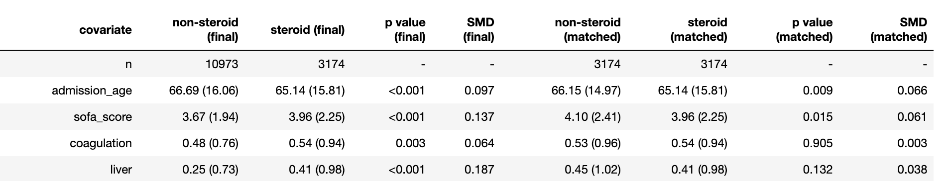
Results – Did not reveal better outcomes in patients administered with steroids
Primary outcome analysis with four different models
Worse outcomes using models without adjustments for propensity score, and using IPW
Possible that treatment group was more clinically severe as clinical guidelines are to provide steroids if fluid resuscitation and treatment with vasopressors do not restore hemodynamic stability
Non-treatment group had lower SOFA scores when unmatched
No significant difference found when using model with propensity score matched cohort
Method | OR (odds ratio) | CI |  | p value
 |  | 2.5% | 97.5%
Doubly robust with unbalanced covariates | 1.17 | 1.04 | 1.33 | 0.011
Doubly robust with all covariates | 1.29 | 1.13 | 1.48 | < 0.001
Propensity score with IPW | 1.1 | 1.07 | 1.26 | < 0.001
Propensity score matching (with subgroup analysis) | 1.01 (all) 0.96 (severe) 0.94 (non-severe) | 0.90 (all) 0.78 (severe) 0.81 (non-severe) | 1.14 (all) 1.16 (severe) 1.08 (non-severe) | 0.81 (all) 0.65 (severe) 0.36 (non-severe)

Slide 9
Results – Did not reveal better outcomes in patients administered with steroids
Method | OR (odds ratio) | CI |  | p value
 |  | 2.5% | 97.5%
Doubly robust with unbalanced covariates | 1.17 | 1.04 | 1.33 | 0.011
Doubly robust with all covariates | 1.29 | 1.13 | 1.48 | < 0.001
Propensity score with IPW | 1.1 | 1.07 | 1.26 | < 0.001
Propensity score matching (with subgroup analysis) | 1.01 (all) 0.96 (severe) 0.94 (non-severe) | 0.90 (all) 0.78 (severe) 0.81 (non-severe) | 1.14 (all) 1.16 (severe) 1.08 (non-severe) | 0.81 (all) 0.65 (severe) 0.36 (non-severe)
Secondary outcome analysis with propensity score matching cohorts
Secondary outcomes of 28-day ICU-free days and 28-day ventilator-free days were significantly higher in the no-treatment group, implying that steroids administration resulted in worse outcomes
The results of the study imply a need for greater examination of the effect steroids have on sepsis patients in creating a clinical recommendation to ensure the administration is beneficial

Slide 10
Limitations of current study to be addressed in future work
As implied by difference in results after propensity matching, sepsis patients who are administered steroids are clinically worse compared to those who are not
Possible that treatment group is still more clinically severe compared to non-treatment group despite propensity matching
Unknown if steroids was administered to treat sepsis or due to other conditions
Dose was not measured and could potentially be a hidden confounder as prior meta-analyses have found lower dose steroids to be more beneficial

Slide 11
Proposed future work
Study results imply steroids were not beneficial sepsis patients; to identify and address biases
Future studies may consider a stricter definition of sepsis that only includes patients severe enough to justify steroids administration for both the non-treatment and treatment groups
Dose should be considered for sub-group analysis as well. Potentially the types of steroids and doses accepted as treatments can be reduced
Ideally, the date of sepsis diagnosis should be available so that only steroids given after diagnosis are included as treatments

Slide 12
Conclusion
This study found an increase in 28-day mortality in an inverse proportional weight model using propensity score and no significant difference when using a propensity matched model
Comparison between propensity matched samples also did not reveal better outcomes for 28-day ICU-free days and 28-day ventilator-free days
However, biases in this study have to be addressed and future studies should be designed to control for the biases

Slide 13
References
Liang H, Song H, Zhai R, Song G, Li H, Ding X, Kan Q and Sun T (2021) Corticosteroids for Treating Sepsis in Adult Patients: A Systematic Review and Meta-Analysis. Front. Immunol. 12:709155. doi: 10.3389/fimmu.2021.709155
Fang, F., Zhang, Y., Tang, J., Lunsford, L. D., Li, T., Tang, R., He, J., Xu, P., Faramand, A., Xu, J., &amp; You, C. (2019). Association of corticosteroid treatment with outcomes in adult patients with sepsis. JAMA Internal Medicine, 179(2), 213. https://doi.org/10.1001/jamainternmed.2018.5849
Rochwerg, B., Oczkowski, S. J., Siemieniuk, R. A., Agoritsas, T., Belley-Cote, E., D’Aragon, F., ... & Guyatt, G. (2018). Corticosteroids in sepsis: an updated systematic review and meta-analysis. Critical care medicine, 46(9), 1411-1420.

Slide 14
Supplementary
Statistical models used in current study
Top 30 covariates based on feature importances using a GBC model
GBM model evaluation and hyperparameter tuning
Basic demographics of final and matched cohort (top 30 covariates)
SOFA score distribution of final and matched cohorts
Prior meta-analyses

Slide 15
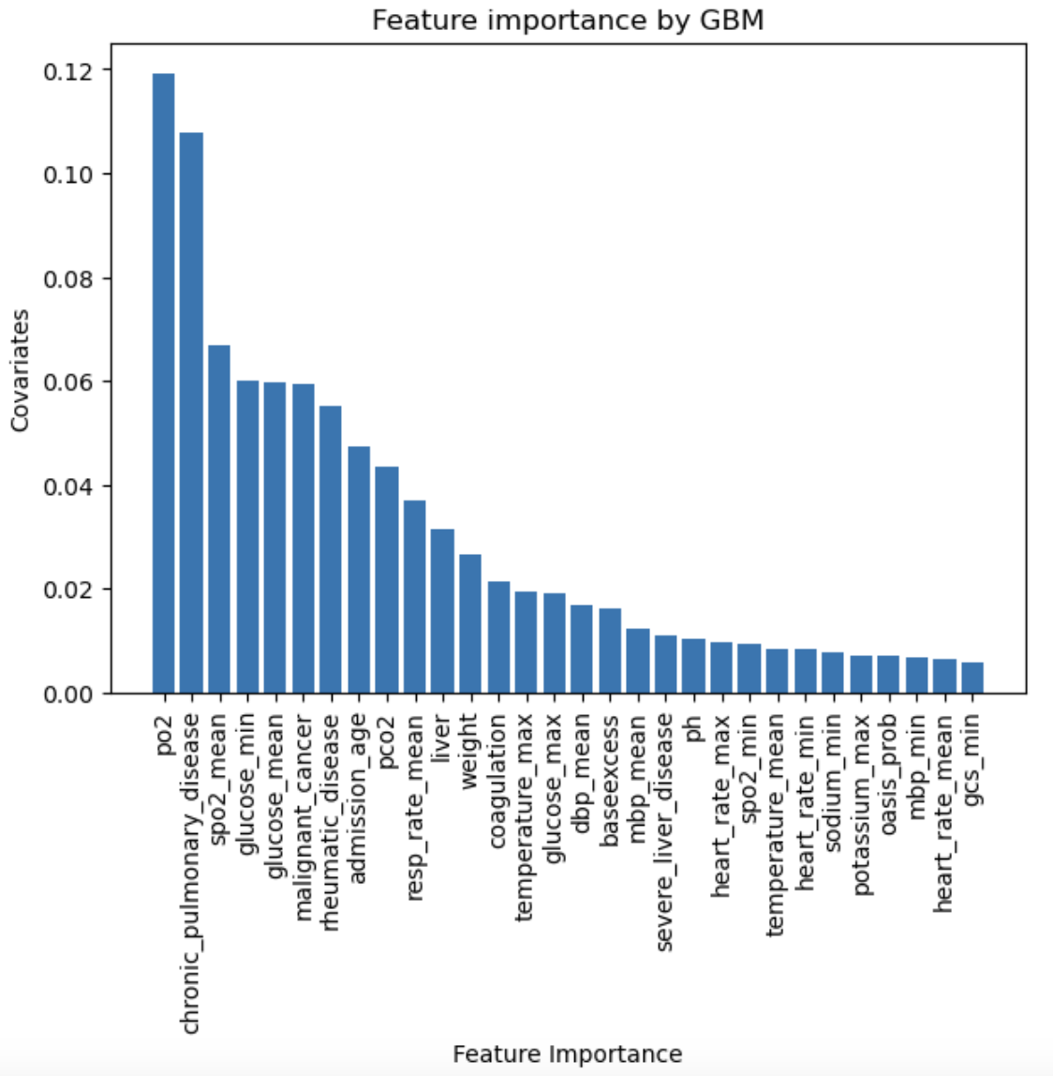
Feature importance from GBM

Slide 16
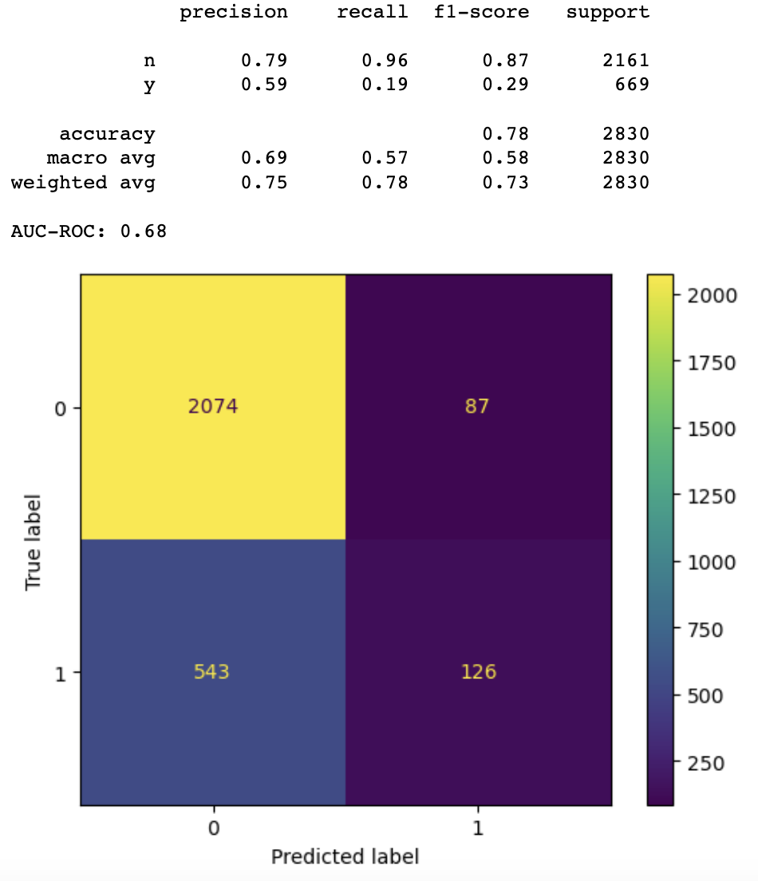
GBM model evaluation

Slide 17
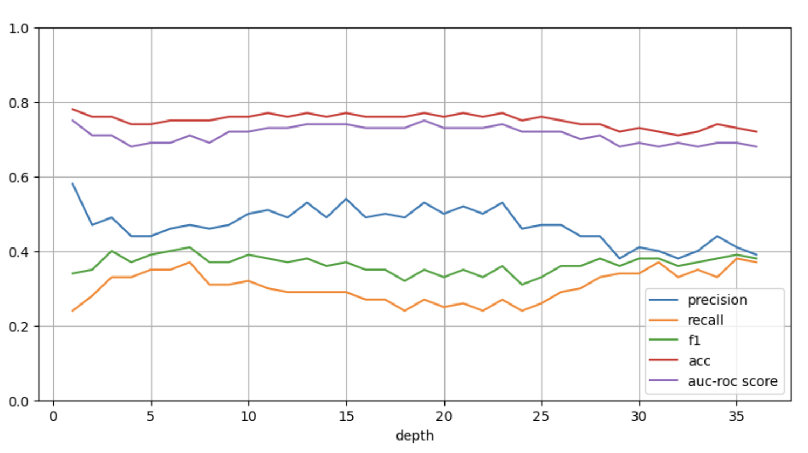
GBM model hyperparameter tuning

Slide 18
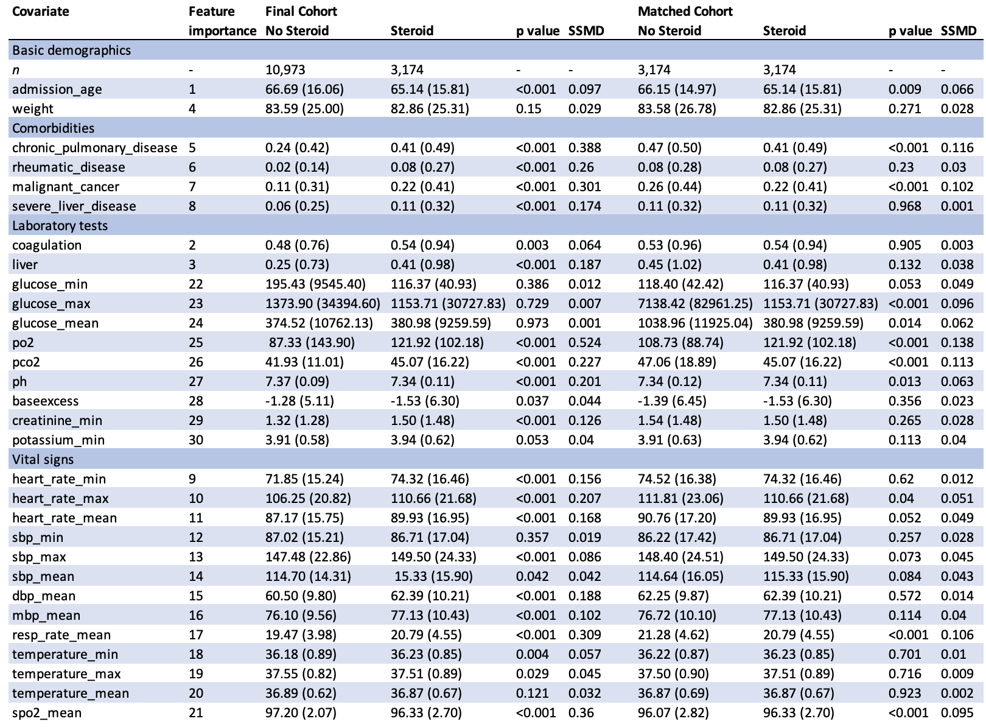
Basic demographics

Slide 19
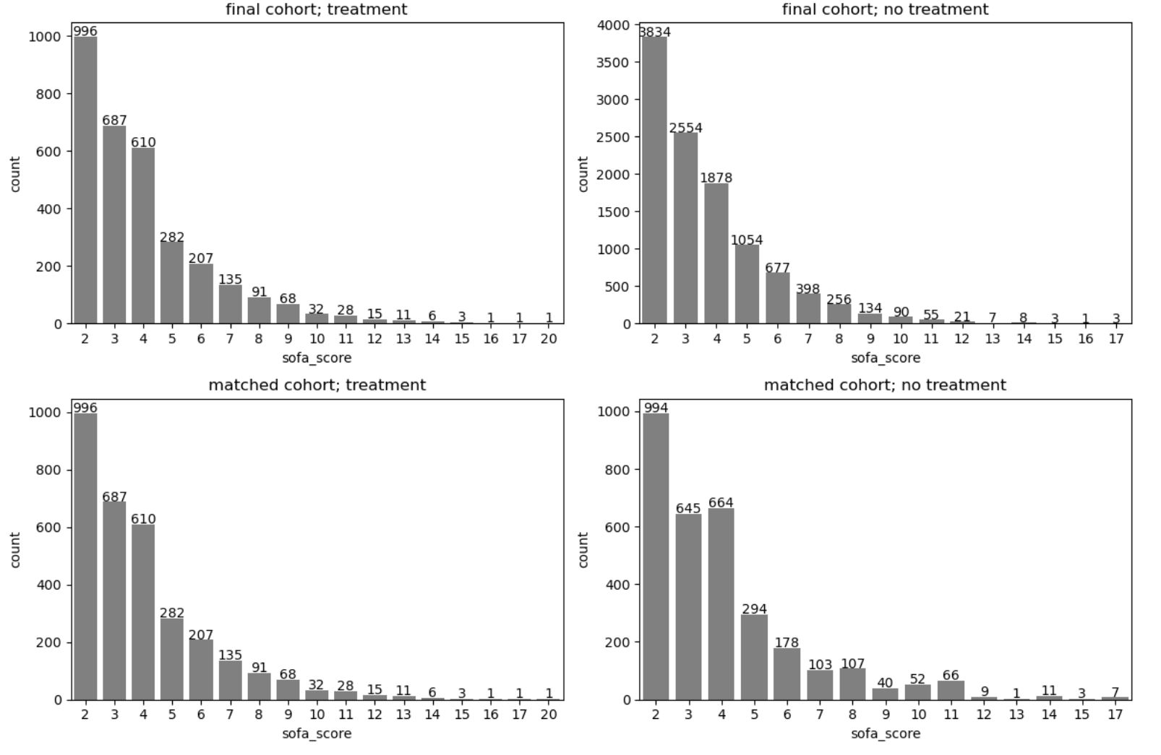
COHORT by SOFA SCORE severe: sofa_score ≥5 non-severe = sofa_score ≤4≤4 ref https://www.ahajournals.org/doi/10.1161/JAHA.117.008169

Slide 20
Prior meta-analyses on subject
Fang et al (2018) studied 37 RCTs and found significant reduction in 28-day mortality, ICU mortality, and in-hospital mortality for sepsis patients treated with steroids
No significant difference was detected for 90-day mortality or for high-dose corticosteroids
Liang et al (2021) studied 50 RCTs and found no significant difference in 28-day mortality but significant reduction in in-hospital mortality and ICU mortality with steroids treatment
Rochwerg et al (2018) studied 42 RCTs and found no significant reduction in mortality, ICU length of stay, or hospital length of stay

